Slide 1
Képszintézis
Optikai és radiometriai alapok
Szécsi László

Slide 2

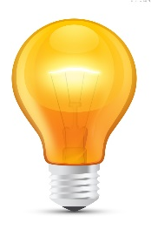
Illusion of the real world
tone
mapping
pixel
virtual world
λ
λ
color
real world
λ
λ
λ
Notes:
In order to compute the image, the power arriving at the eye from the solid angle of each pixel needs to be determined on different wavelengths.
We establish a virtual world model in the computer memory, where the user is represented by a single eye position and the display is represented by a window rectangle. Then we compute the power going through the pixel toward the eye on different wavelengths, which results in a power spectrum.
If we can get the display to emit the same photons, then the illusion of watching the virtual world can be created. As the human eye can be cheated with red, green, and blue colors, it is enough if the display emits light on these wavelengths. The last step of rendering is the conversion of the calculated spectrum to displayable red, green and blue intensities, which is called tone mapping. If we compute the light transfer only on these wavelengths, then this step can be omitted and the resulting spectrum can be used directly to control the monitor.
One crucial question is what exactly should be computed that describes the strength of the light intensity and when the pixel is controlled accordingly, provides the same color perception as the surface. Note that the pixel is at a different distance than the visible surface. The orientations of the display surface and of the visible surface are also different. The total emitted power would definitely be not good since it would mean less photons for the eye for farther sources.

Slide 3
A fény fizikai mértékei
radiant power - teljesítmény
power density - teljesíménysűrűség
radiant exitance - exitancia
irradiance - irradiancia
radiant intensity - intenzitás
radiance - radiancia, sugársűrűség
Notes:
Light is electromagnetic radiation in the range of visible wavelengths. We need to turn to physics, and to radiometry in particular, to find out what measures of light can be used to express the quantities we are interested in.
Here listed are the phrases we need to use to talk about light in pedantic terms. Admittedly, you can get quite far in computer graphics without having a clear idea about how these are different from each other, by just using the quite simple formulae we will eventually arrive at, or even just trusting OpenGL to apply them correctly for you. However, if we wish to understand what we are doing, we have to start here. Let us review them one by one.

Slide 4


Watt [ W ]
~ átlépő fotonok száma másodpercenként
Notes:
A well-known measure of light is wattage, or power. A light bulb is characterized by its electrical power uptake, given in watts. Admittedly, much of that wattage goes to heating the bulb, but some of it is converted to light.
We can imagine light as lots of identical photons travelling along straight lines --- wave properties of light need not be considered for 3D rendering, and the fact that real photons have different wavelengths we can address later, when we already have a system for uniform-wavelength photons, i.e. monochromatic light.
Every photon carries the same amount of energy. The power is therefore propertional to the number of photons leaving the bulb., or, more accuratelty put, the number of photons crossing the surface of the bulb. In a similar manner, we can talk about the power of light arriving at a wall (or the surface of any object). We can talk about the power of light reflected from the same wall. We can talk about the power flowing through any surface. For that reason, radiant power is also called radiant flux.
This, of course, does not directly tell us what a piece of surface appears like. Power can be distributed on the surface arbitrarily, and the same can be said for the directions: there might be more photons crossing at some directions than others.

Slide 5
Watt per négyzetméter [ Wm⁻² ]
Notes:
It is a straightforward improvement to measure the power emitted per unit area instead of the total power. This removes the total surface area of the emitter from the measure. We get a density-like measure, which is often called power density. As we are talking about photons leaving a surface, the term radiant exitance is the proper one. Of course, emission might be not homogenous over the surface, making this measure a function of position x. The symbol for radiant exitance is M, and the SI unit is Watts over square meters.
Is this measure telling us how bright some surface point appears to be? It tells us how densely photons are emitted from around the point, but not if they are emitted towards our eye.

Slide 6
Watt per négyzetméter [ Wm⁻² ]
Notes:
If we are referring to the density of photons incident on a surface, then we call the same measure irradiance. The symbol is E, and the unit is of course the same. Giving these different names and symbols is quite useful for clarity, as the power density arriving at a surface is of course typically not the same as the power density leaving a surface.

Slide 7

Han lőtt előbb
Notes:
Let us measure the irradiance of Captain Solo’s laser beam as its pierces through the table board and as it hits Greedo’s vest. We are going to assume piercing that hollow barrel of a table did little enough to the power of the ray so that can be neglected.

Slide 8
Számoljuk meg a felületen áthaladó fotonokat!
Greedo felülete
10
20
25
15
5
0
40
30
35
45
27
az asztal felülete
Notes:
We model the blaster beam as a coherent, unidirectional beam of photons. Let us count the number of photons crossing a unit area of both the table surface and Greedo’s surface, for the same duration of time. The blaster pierces the table at an angle, so its power is distributed on a larger area (5 units here), whereas it hits Greedo quite directly, over 3 units of area.
Counting the photons we see that the irradiance on the two surfaces is not the same at all, even though it is the same beam of photons and the “density of light” has of course not changed. This is because irradiance is defined over unit surface, and the surfaces are not the same. Their orientation matters. Thus, we cannot talk about irradiance at a point in space without specifying a surface orientation there. When a well-defined direction is known – as is the case with a coherent blaster beam or when the source of light is very distant – it is natural to take a perpendicular surface to express power density, but this does not just go without saying.

Slide 9


Hogyan jellemezhetjük, hogy adott irányba milyen erősen ad egy rádióadó?
A teljesítménysűrűség a mérés távolságától is függ
Itt az irányok szerinti eloszlás az érdekes
?
?
Notes:
Although it is tempting to use the word ‘intensity’ as synonymous to any measure of light, the term is actually taken and has well-defined meaning. It is somewhat less prevalent in computer graphics, but it is a very basic measure in radiofrequency technology.
An important property of a radio transmitter antenna is in which directions it emits more radiation. Imagine a GPS transmitter on the roof of your home: you might be comforted to know that the downward radiation is practically zero.
Measuring the power density at some point is meaningful of course, but it does not characterize the transmitter itself. The further you measure, the less the power density is going to be, as power is distributed over a larger area. At double the distance, the area grows double in both dimensions, diminishing power density by a factor of four – this is the inverse square law.
Thus, what RF engineers are interested in when characterizing the antenna is not the distribution of power over surface, but distribution of power over directions. The measure called radiant intensity is thus going to be a function of direction ω. But how do we express directions in 3D, and what is the analogue to what was the area of a surface, and what units is it measured in?

Slide 10
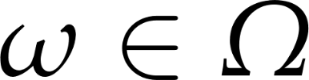
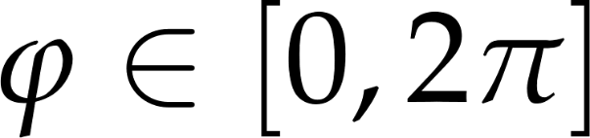
Az iránytartomány
2D
3D
θ
ϕ
az irányok az egységkör pontjaihoz rendelhetők
az irányok az egséggömb pontjaihoz rendelhetők
Notes:
Everyone is familiar with directions and the measure of direction sets in 2D. Directions correspond to points on the unit circle. A direction can always be given as an angle from the reference direction. In 3D, we need three reference directions, and both the polar and azimuthal angles. Directions correspond to points on the unit sphere. Of course, directions can be represented by the position vectors of the points, i.e. unit-length vectors.
A direction could either be represented by a vector or the two angles, but it is a geometrical entity on its own right, and of course it admits itself to different operations than a vector. Thus, we usually just use the symbol ω for a direction – and only write a direction as a vector when sets of directions are no longer involved. The symbol Ω is used for the complete set of directions.

Slide 11
Sík- és térszögek mértékei
2D
3D
radian [rad]
ívhossz az egségkörön
a teljes tartomány: 2π
steradian [sr]
a térszögben látszó felület az egységgömbön
a teljes tartomány: 4π
Notes:
In 2D, a contiguous set of directions makes an angle. The measure of that angle is the length of the arc subtended on the unit circle. This measure also has an SI unit, the radian, even though it is dimensionless. We all know that the measure of the complete domain is 2π.
In 3D, a contiguous set of directions -- called a solid angle -- makes some kind of shape on the surface of the unit sphere. The measure of the solid angle is the area of this shape. The dimensionless SI unit is called the steradian. You may be uncomfortable with the fact that we do not specify the shape of the solid angle in any way. You should not be. Just as the pint is a perfect measure of volume without a relation to a measure of lower dimension or having an established shape, so is the steradian perfect for measuring solid angles. Just as we can talk about the number of bubbles per pint, we can also talk about the number of photons per steradian. Or watts per steradian, of course.

Slide 12

Watt per steradian [ W(sr)⁻¹ ]
Notes:
Radiant intensity has the unit of watts per steradian. It is a density-like measure, but instead of distribution over area, it measures distribution over directions. The symbol is I, and intensity is a function of direction ω.
It we split the directional domain into small solid angles, and count the number of photons exiting in them, we can plot radiant intensity. With infinitely small solid angles, the get a function with a continuous domain..
Now, is radiant intensity the measure we are looking for? Does it characterize the appearance of a surface point? Well, it seems to work for the radio transmitter or the light bulb, but only if those are so small they can be considered point-like. If we consider an extended surface, knowing the overall directional distribution of photons is not enough, as light emitted from different surface points in the same direction will travel different paths.
To be able to tell what light hits our eye, we need a measure that takes both directional and area distribution into account.

Slide 13


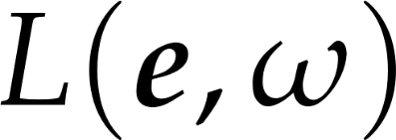
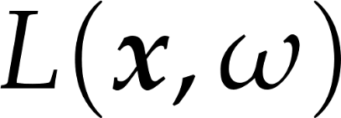
Sűrűség a pozícióra és az irányokra nézve egyaránt
Kifejezi, mennyi fény halad
a tér egy bizonyos pontjában
egy bizonyos irányba
szem
=
felületi pont
Notes:
This measure is radiance. This is absolutely the most important measure in computer graphics, and when less educated graphics programmers talk about light intensity, they most often should say radiance instead.
Radiance is density of radiant power with respect to both position and direction. We are going to examine it more rigorously, but let us first consider intuitively what it can express and why it is a good measure for us.
Radiance is a function of both position and direction. Although we have been talking and will continue to talk in terms of surfaces, radiance can be interpreted at any point in space (if there is no surface there, just image we put one there). Thus, our complete virtual world can be imagined as a continuous, five-dimensional (3D for position, +2D for directions) radiance field. Of course we will only be interested in the radiance at certain points and directions, but the field is still there.
Now consider two points in space, and their radiances along the line that connects them. We know that light travels along straight lines. So what is the relation between the radiance at those two points? If there is no object in between to block the light, no medium that scatters the light, and no interfering light source that adds more radiance, the flock of photons travelling along one arrow will be the same as the photons travelling at the other. Radiance will not change along rays of light.
Now imagine at one point is our eye, and at the other a surface point. If we manage to find the radiance exiting the surface toward the eye, than we have also managed to find the radiance arriving at the eye from that given direction.
Let us look at the proper definition of radiance, and see that the above properties indeed are true and radiance can be used to characterize the appearance of surface points.

Slide 14





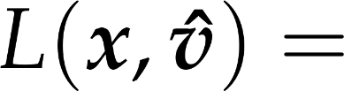



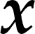
Watt per steradian per négyzetméter [ W(sr)⁻¹m⁻² ]
vetített
kibocsátott teljesítmény
egységnyi felület által
egységnyi térszögbe
Notes:
Radiance is defined as the power divided by the projected surface and the solid angle of emission.

Slide 15

Radiancia és pixelszín
Notes:
An important theorem states that if two surfaces have the same radiance, then they look identical no matter whether they are at a different distance or have different orientation. The proof is based on that if in a solid angle the eye would gather the same number of photons, i.e. energy, then it would not be able to distinguish source surfaces. Let us compute this power for two surfaces that are seen in the same solid angle and have the same radiance.
If the surface is closer, then its real area is smaller, but the solid angle in which the pupil of the eye can be reached from this surface is larger. Both the solid angle and the surface changes with the square of the distance and the two factors compensate each other. If the surface is not perpendicular to the viewing direction, then the surface seen in a given solid angle is larger, but the cosine factor will be proportionally smaller, so again we see no difference.
So, the conclusion is that we should compute the radiance of a surface and set the pixel of the display to have the same radiance. Then the two surfaces will be identical for the eye.
The fact that surfaces having the same radiance but at different distances look similar can also be interpreted as that the radiance does not change along a ray.

Slide 16
A hullámhosszok függetlenek
A relativisztikus tömeg kicsi
Rugalmas ütközésben a foton energiája (vagyis hullámhossza) nem változik
Az elnyelődés valószínűsége ettől még függhet a hullámhossztól és az anyagi jellemzőktől
e⁻
e⁻
Notes:
The human eye is sensitive to the wavelength of the light so the simulation should be carried out on different wavelengths. Fortunately, different wavelengths can be handled separately, they cannot affect each other. An object illuminated by red light can never turn to green, yellow or blue. It can only be a darker version of the color of the illumination. When the object is illuminated by white light, the same rule applies on each wavelength separately. If the objects absorbs red and green light, the reflected color will be blue, because only blue remains from the incident spectrum.
The explanation of this wavelength independence is that photons on the visible spectrum have low energy, therefore small relativistic mass. When a photon collides with the particles of the matter, mainly with electrons, it either elastically bounces off or it gets absorbed. Since the electron’s mass is much greater than the relativistic mass of the photon, upon collision all energy remains for the photon, the electron stands still.

Slide 17
Nagyobb energiájú sugárzásnál ez nem teljesül
A gamma-foton relativisztikus tömege az elektronéval összevethető
A foton energiája (hullámhossza) változik szóródáskor (Compton-hatás)
e⁻
e⁻
Notes:
This is not so simple in high energy radiation, e.g. X-ray or gamma photons where the photons’ relativistic mass is comparable to the mass of the electron.
Here during elastic scattering the energy of the photon can decrease since it pushes the electron, and consequently, different wavelengths cannot be computed separately.

Slide 18
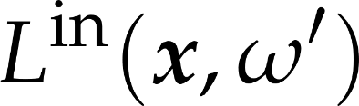
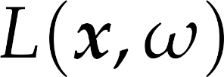
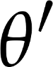

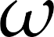
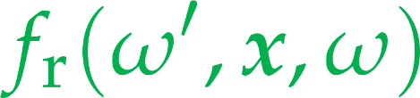
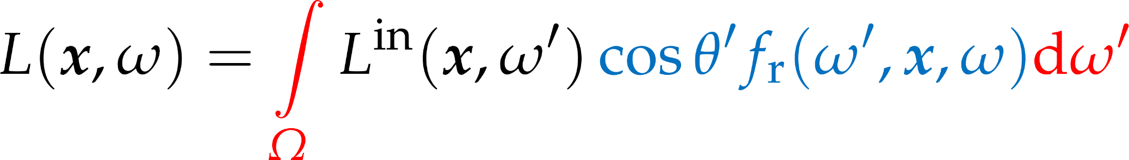
Az árnyalási egyenlet
Notes:
The Holy Grail of computer graphics is the rendering equation. This expresses how much light a certain surface point reflects into a certain direction, i.e. what color a surface appears under given lighting conditions.
Although the rendering equation is a formidable-looking integral equation with term yet unexplained, its meaning can be put in words quite simply. Also, after simplifying assumpltions andwith simple lighting and material models, the rendering equation will turn in pretty simple and swiftly computable formulas.
The rendering equation expressed the outgoing radiance L towards direction ω from shaded surface point x, as the radiance incoming from all directions, times the probability it is reflected towards the outgoing direction.
The factor cosθ’ f_{r}(ω’, x, ω) expresses the probability density of a photon incoming from ω’ refected towards ω. We will examine it further in the following slides.
In the real world, in most situations, some radiance is going to be incoming from all directions, reflected from the surrounding surfaces. However, actually computing this integral (an approach called global illumination) would lead to immense computational costs and very slow, if realistic, rendering. Thus, we consider a simpler theoretical case: when all light is incoming from a single direction.

Slide 19
Különleges esetek
ideális, sima felület
csak egy adott irányból bejövő fény verődhet vissza a kimenő irányba
csak egy adott irányból bejövő fény törhet a kimenő irányba
csak egy irányból jön be fény
nem kell integrál

Slide 20
Sima felületek
ideális visszaverődési irány
transzmittancia
reflektancia
ideális törési irány

Slide 21
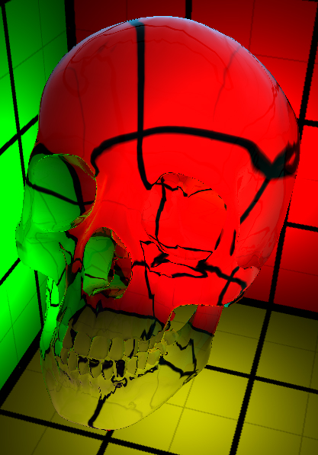

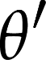
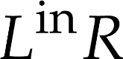
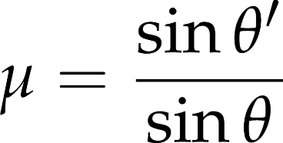
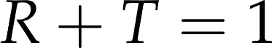
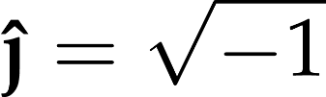

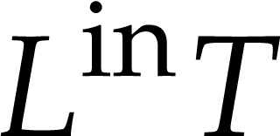
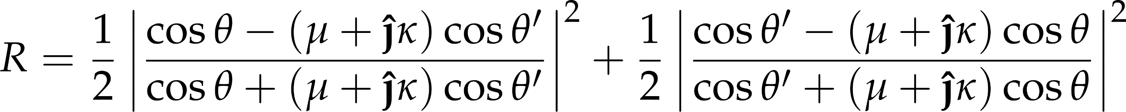
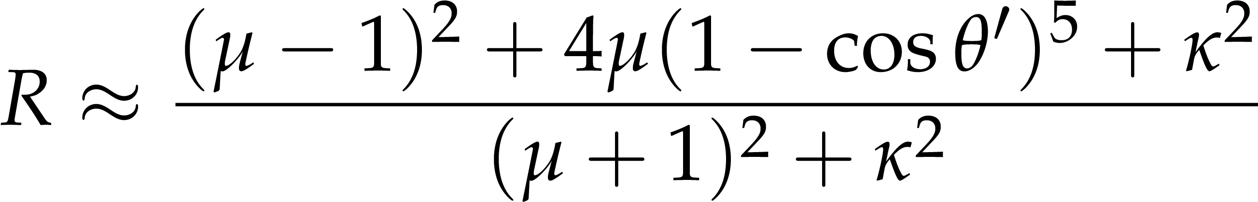
Fresnel egyenletek
reflektancia
kioltási tényező
transzmittancia
törésmutató
Notes:
The simplest arrangement for the light transfer is a single plane that separates the space into two half spaces of different materials. According to the laws of geometric optics, the illumination ray is broken to a reflection ray meeting the reflection law and a refraction ray obeying the Snell’s law of refraction. Here μ is the index of refraction, which expresses the ratios of speeds of light outside and inside the material. The Fresnel equations define the amount of reflected energy (i.e. the probability that a photon is reflected). The Fresnel function can be calculated from index of refraction μ, extinction κ, incident angle θ’ and refraction angle θ. The extinction is negligible for non-metals. We also show a simplified Fresnel term (Schlick’s approximation).
In practice, we can use the simple Schilck formula to find the reflectance. In this formula, R0 is the reflectance for light incoming perpendicular to the surface. The lower the incoming direction is, the more of the light is reflected. Transmittance is 1 - R.

Slide 22
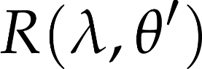
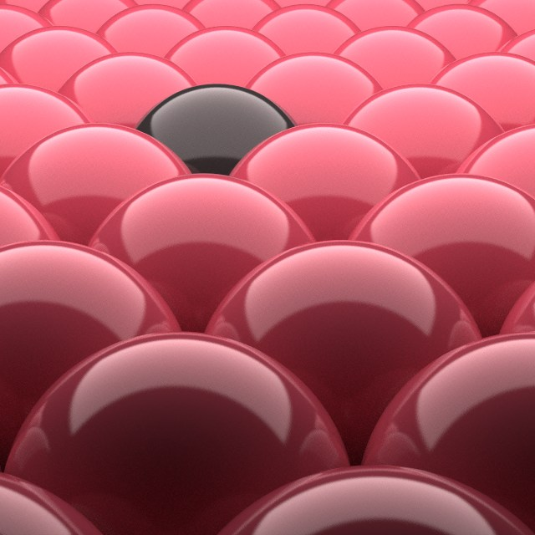
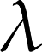
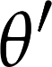
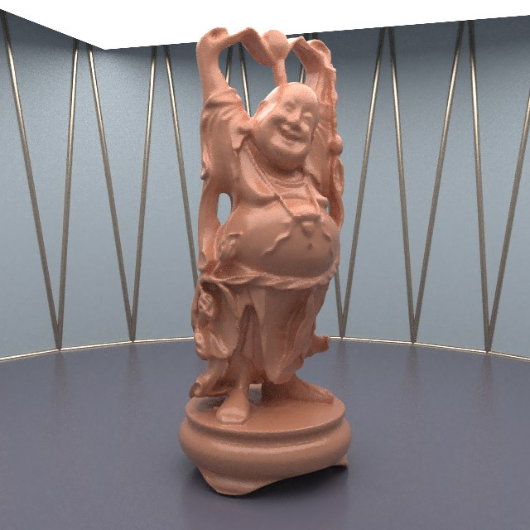
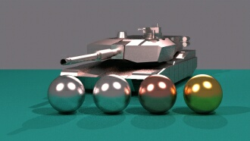
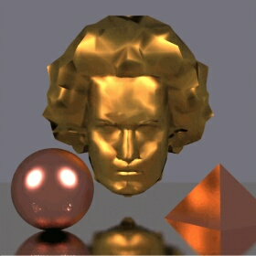
Fresnel függvény
arany
ezüst
Notes:
The Fresnel function depends on the wavelength and on the incident angle. When we see an object, we can observe surfaces of many different orientations, so we perceive the Fresnel function as a whole.

Slide 23

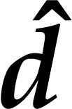
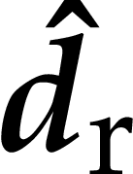

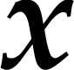

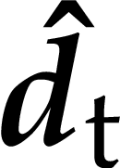
Jelölések
felületi pont
felületi normálvektor
bejövő fényirány
ideális visszaverődési irány
ideális törési irány
bejövő/visszaverődési szög
törési szög
Notes:
Note that d points inwards.
Why do we use d and not l? Because the light incoming here is not necessarily from an abstract light source, and in our practice, it never will be. Furthermore, d points inward and l would point outward.

Slide 24


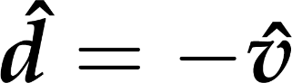
Elsődleges (szemből induló) sugár esetén
Notes:
Although the Fresnel law describes the case of incoming light separated into a reflected and a transmitted part, because of the symmetry of the BRDF this also works the other way round: if we look at the surface point from direction –d, the radiance reflected towards the eye, along direction -d, is the radiance incoming from d_{r} times the Fresnel reflectance plus the radiance incoming from d_{t} times the Fresnel transmittance.

Slide 25
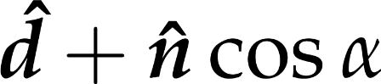
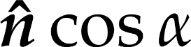
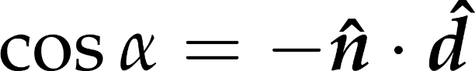
Ideális visszaverődés iránya
vec3 reflect(vec3 inDir, vec3 normal)
{
return
inDir - normal *
dot(normal, inDir) * 2.0;
};
Notes:
To render smooth surfaces, we should compute the ideal reflection direction. Assume that incident direction d and surface normal n are unit length vectors.
Incident direction d is decomposed to a component parallel to the normal and a component that is perpendicular to it. Then, the reflection direction is built up from these two components.

Slide 26
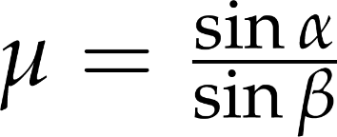
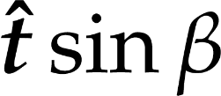

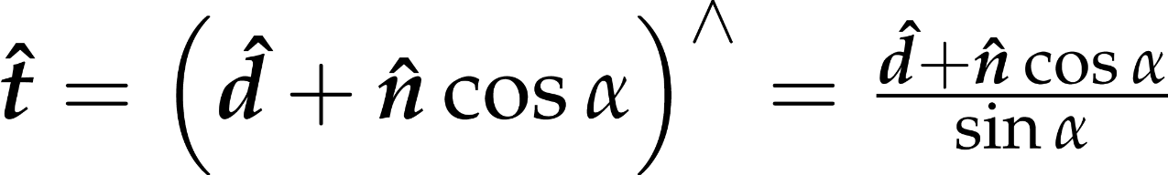
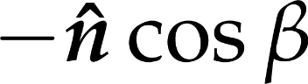
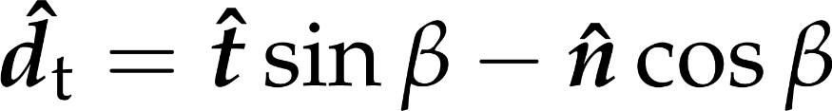
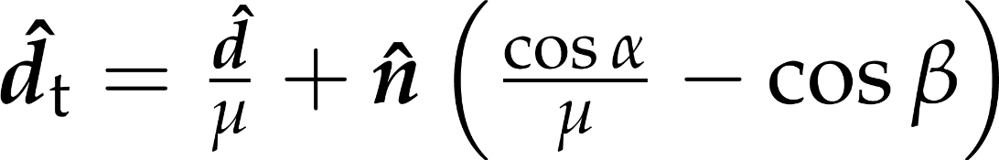
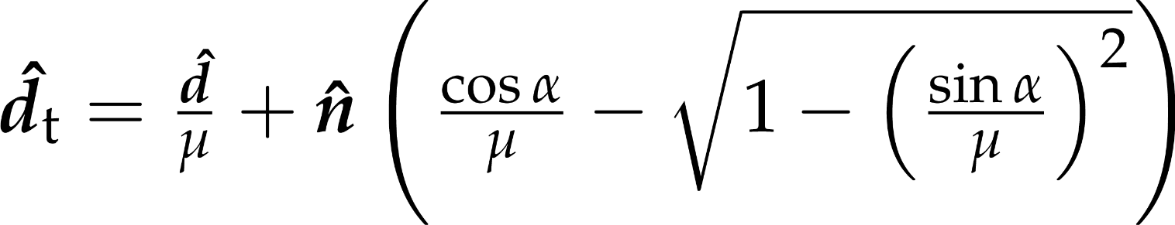
Ideális törés iránya
Snellius-
Descartes
α
β
Notes:
The refraction direction calculation is also similar. The refraction direction d_{t} is expressed as a combination of the normal vector and a vector that is perpendicular to the normal, t. These vectors should be combined with weights cos(beta) and sin(beta) where beta is the refraction angle.
As in the reflection case, d is decomposed into perpendicular component n cosα and parallel component d + n cosα. The parellel component is of course perpendicular to the surface normal. Its length is sin α. Thus, dividing d + n cosα by sin a gives us t, a unit tangent vector of the surface. Because of Snell’s law, we know that the tangential component of the refracted direction is tsinβ. To make the refracted vector unit length, the normal component must be ‒ ncosβ.
Now, using Snell’s law to eliminate beta, and cos*cos + sin*sin = 1 to eliminate sines, we get the formula for the ideal refracted direction expressed with the refractive index and the incoming light angle.

Slide 27
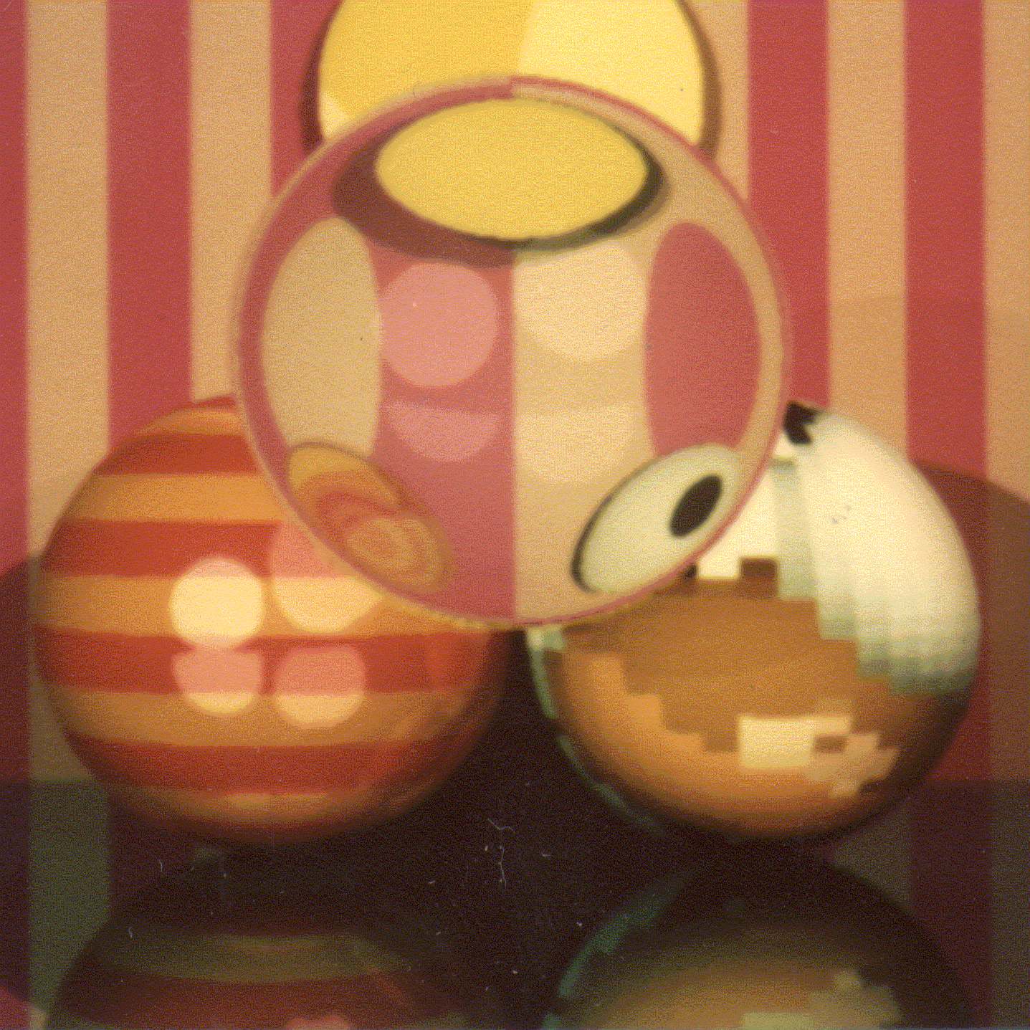
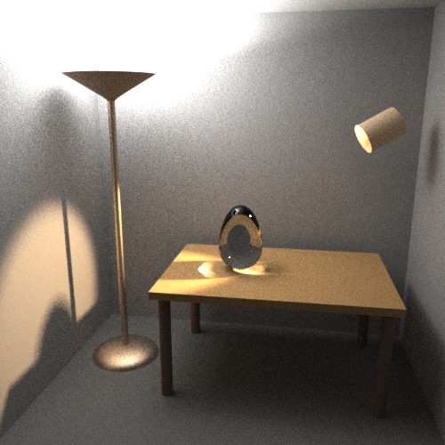
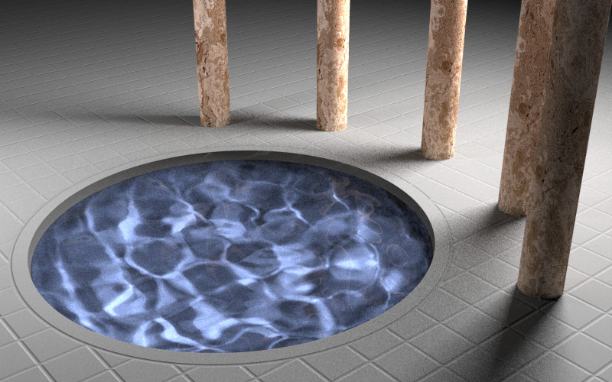
Törő és tükröző felületek

Slide 28

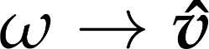
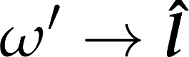
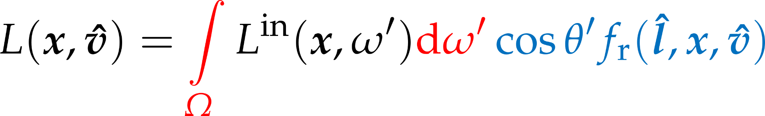

Ha egyetlen irányból jön fény
teljesítménysűrűség
irradiancia
Notes:
If all light is incoming from a single direction, the incoming radiance function has zero value for every direction but the light direction l. At the same time, we want the total incoming power per unit area be something finite. All this finite power density is concentrated on a zero-size solid angle, making the incoming radiance from l infinite. Thus, the radiance is a Dirac-delta function.
The reflection probability factor is now only required for incoming light direction l, as for all other directions, it is multiplied by zero incoming radiance. The factor now devoid of the integration variable ω’ can be moved out of the integral. What remains is the directional integral of the radiance, which is the power density of the incoming light, on a surface perpendicular to the light direction.
Now we can start to explain why we separated the reflection probability factor into a cosine factor and the rest. The cosine of the incoming light angle gives the ratio of the perpendicular surface area over the actual surface area . Mutiplying the power density with this cosine factor, we get the irradiance on the surface.
The factor f_{r}(l, x, ω) therefore must express the outgoing radiance as a function of incoming irradiance., which depends on the optical properties (i.e. the material) of the surface.

Slide 29







Szemirányú radiancia egy irányból érkező irradiancia hatására
a szemirányú radiancia
a fényirányból bejövő irradiancia szorozva
a nézeti irányba történő visszaverődés valószínűségsűrűségével
Notes:
In the previous slide, we have already taken the liberty of denoting directions with unit length vectors, namely light direction l is a unit length vector. As we no longer have to deal with integration over directions, the distinction between directions and unit vectors becomes irrelevant, and we can write all our quantities as function of vectors instead of directions.
The concrete case of reflection that is of interest to us is when we wish to compute the eye-directional radiance of a surface point visible in a pixel. The view direction we denote by unit vector v, the light direction with unit vector l, the surface point is at x. If the incoming irradiance in known, the eye-directional radiance can be computed with this formula. Now it is time to reveal what Fr is.

Slide 30




A kétirányú visszaverődés valószínűségsűrűség-függvénye - BRDF
az felületi pontban az irányból belépő egységnyi teljesítménysűrűség hatására a irányba kilépő radiancia
ez a felület optikai jellemzője
Helmholz-törvény
[ (sr)⁻¹ ]
Notes:
Fr is the BRDF, or bideirectional reflectance distribution function. It expresses the outgoing reflected radiance in a certain direction in response to unit irradiance from a certain incoming direction. The BRDF can of course also depend on the surface point: not only materials or colors may be different at different surface points, but also the surface may have different orientation, meaning that the same incoming and outgoing directions might be very different with respect to the surface.
The BRDF is a physical property of surfaces. It should obey certain laws of physics. Energy conservation is one such law: a surface should not reflect more light than incident on it. Another is Helmholz’s law: the BRDF is symmetrical, the incoming and outgoing directions interchanges should result in the same reflectance value.

Slide 31


Egy felületi pont árnyalása
fényforrás-modellből
anyagmodellből
Notes:
Now we have an outline of an algorithm for shading a surface point (shading here means finding the eye-directional radiance, i.e. the color of the pixel in which the surface is visible.)
We need as inputs the surface point position, the surface normal there, the eye and light positions.
View and light directions can be computed by subtracting the surface point position from eye and light positions, and normalizing the vectors.
Then, we need to find the incoming power density (on a surface perpendicular to the light direction). This will depend on the lighting model we use,
Then, we compute the cosine of the light angle.. This is the dot product of the surface normal and the light direction.
The product of the power density and the cosine factor given the incoming irradiance.
The irradiace multiplied by the BRDF given the eye-directional radiance. The BRDF comes form the optical material model we use,
Thus, to make this outline a complete shaing algorithm, we are missing two components: the model of light sources and the model of optical material properties.

Slide 32




Valós fényforrások
nem egyetlen bejövő fényirány van
ki kell értékelni az integrált
Notes:
Real light sources are defined by their emission radiance, L^{emitted}. When the reflected radiance of a point is considered, the contribution of all those light source points should be added which are visible from the point of interest. This means integration. Thus, we often prefer abstract light source models, that can illuminate a surface just from a single direction, which saves integration.

Slide 33

Absztrakt fényforrásmodell: irányfény
Notes:
In case of directional light sources, the radiance is constant everywhere, so is the illumination direction. In other words, the illumination rays are parallel. The Sun is an example for directional light source if we are on the Earth.

Slide 34
Abstract light source model: directional light
lightPosition
∞
powerDensity
lightDir
light source defined by
light direction, given as an ideal homogeneous position
lights[i].position
:= vec4(unit-length direction towards light, 0)
power density, any positive value, given at RGB wavelengths
lights[i].powerDensity := vec3(red, green, blue)
everywhere, at any shaded surface point
the same vec3 lightDir = normalize(lights[i].position.xyz)
the same vec3 powerDensity = lights[i].powerDensity
Notes:
In case of directional light sources, the radiance is constant everywhere, so is the illumination direction. Thus, the data required for shading is directly given, and there is no need for computation.
The Sun is an example for directional light source if we are on the Earth.

Slide 35
Simple shading in FS
!
vec3 lightDir = normalize(vec3(1, 1, 1));
float cosa = clamp(
dot(lightDir, normal),
0.0,
1.0);
define a light direction vector
points from surface towards light
can be hardwired as a constant
you may replace with a uniform later to animate lighting direction
compute cosine of angle between normal and light
use the dot function
what if the cosine is negative?
return texture color multiplied by this cosine
take care to only scale the RGB, and leave alpha intact (dark should not mean transparent)

Slide 36
Light data in uniforms
.
new uniforms in FS and matching class in JS:
import vision.gears.webglmath.UniformProvider
import vision.gears.webglmath.Vec3
import vision.gears.webglmath.Vec4
class Light(id : Int, vararg programs : Program) : UniformProvider("lights[$id]") {
val position by Vec4(0.0f, 1.0f, 0.0f, 0.0f)
val powerDensity by Vec3(0.0f, 0.0f, 0.0f)
init{
addComponentsAndGatherUniforms(*programs)
}
}
uniform struct {
vec4 position;
vec3 powerDensity;
} lights[8];
responsible for this array element

Slide 37
Setting up a light in Scene
.
responsible for this array element
in the constructor
in update
val lights = Array<Light>(1) { Light(it, *Program.all) }
init{
lights[0].position.set(1.0f, 1.0f, 1.0f, 0.0f).normalize();
lights[0].powerDensity.set(1.0f, 1.0f, 0.0f);
}
can do this max. 8 times
make sure light direction is unit length
gameObjects.forEach { it.draw( camera, *lights ) }
make sure uniforms are provided

Slide 38
Multiple, colored lights
!
vec3 shade(
vec3 normal, vec3 lightDir,
vec3 powerDensity, vec3 materialColor) {
float cosa =
clamp( dot(lightDir, normal),0.0,1.0);
return
powerDensity * materialColor * cosa;
}
set up two or more light sources
different directions
different power density spectra
in FS, write a for loop, adding contributions of light sources to the fragment color
vec3 lightDir = lights[i].position.xyz;
vec3 powerDensity = lights[i].powerDensity;
fragmentColor.rgb += shade(normal, lightDir,
powerDensity,
texture(material.colorTexture, tex.xy/tex.w).rgb);
reflection model
light source model

Slide 39
Abstract light source model: point light
position
worldPos
lightDir
Notes:
For point light sources, the illumination direction points from the location of the source to the illuminated point. The power density decreases with the square of the distance, as with the photons travelling further, the same power is distributed over a spherical wave front of larger surface area.

Slide 40
Abstract light source model: point light
powerDensity
at unit distance
position
light source defined by
light position, given as a non-ideal homogeneous position
lights[i].position
:= vec4(Cartesian position, 1)
power density at unit distance, any positive value, given at RGB wavelengths
lights[i].powerDensity := vec3(red, green, blue)
at a shaded surface point worldPos.xyz
vec3 lightDiff = lights[i].position.xyz – worldPos.xyz;
vec3 lightDir = normalize(lightDiff);
vec3 powerDensity = lights[i].powerDensity / length²(lightDiff)
worldPos
lightDir
Notes:
For point light sources, the illumination direction points from the location of the source to the illuminated point. The power density decreases with the square of the distance, as with the photons travelling further, the same power is distributed over a spherical wave front of larger surface area.

Slide 41
Point lights – without breaking directional lights
!
// directional case, with lights[i].position.w == 0
vec3 lightDiff =
lights[i].position.xyz // lightDir
– worldPos.xyz * lights[i].position.w;
vec3 lightDir = normalize(lightDiff); // lightDir
float distanceSquared = dot(lightDiff, lightDiff); // 1
vec3 powerDensity =
lights[i].powerDensity
/ distanceSquared;
function shade does not change
reflection model is the same
vec3 lightDiff =
lights[i].position.xyz
– worldPos.xyz * lights[i].position.w;
vec3 lightDir = normalize(lightDiff);
float distanceSquared = dot(lightDiff, lightDiff);
vec3 powerDensity =
lights[i].powerDensity
/ distanceSquared;
// point case, with lights[i].position.w == 1
vec3 lightDiff =
lights[i].position.xyz
– worldPos.xyz * lights[i].position.w;
vec3 lightDir = normalize(lightDiff);
float distanceSquared = dot(lightDiff, lightDiff);
vec3 powerDensity =
lights[i].powerDensity
/ distanceSquared;

Slide 42

BRDF mérése

Slide 43
BRDF mérése
512 kamera
512 vaku
3 hullámhossz
kb. 3 Mbytes adat felületi pontonként
szorozva a képfelbontással
csak akkor van értelme, ha feltétlenül pontosan szeretnénk reprodukálni a valós felület tulajdonságait
pl. a gépjárműiparban

Slide 44
Analitikus BRDF modellek
nagy táblázat helyett egyszerű képlet
több tucat ilyen van
Lambert BRDF model
diffúz visszaverődés, matt felületek
Phong és Phong-Blinn BRDF modellek
spekuláris visszaverődés, fényes műanyagok
Ideális visszaverődés és fénytörés
tükrök, fényes fémek, üveg, víz

Slide 45





Diffúz visszaverődés
radiancia:
független a nézeti iránytól
így a BRDF is független kell legyen a nézeti iránytól
Helmholtz: BRDF független a megvilágítás irányától is
vagyis a BRDF konstans:
a diffúz felület optikailag durva felület
Notes:
Our first model is for very rough surfaces where all photons get reflected multiple times. Such materials (snow, sand, wall, chalk, cloth etc) have a matte look, they look the same from all viewing directions. Thus, the radiance, which equals to the incident radiance times the BRDF times the geometry term, is independent of the viewing direction. Incident radiance and the geometry term are already independent of the viewing direction, thus the BRDF must also be independent of the viewing direction. According to Helmholtz reciprocity, if the BRDF is independent of the viewing direction, it must be independent of the illumination direction as well, so the BRDF is direction independent.
Diffuse surfaces correspond to very rough surfaces where a photon collides many times. The Fresnel depends on the wavelength, which is strong for metals and weak for non-metals. Even if a single reflection changes the spectrum just a little, multiple reflections amplify this effect, so the final reflected light will have a modified spectrum. Diffuse reflection is primarily responsible for the “own color” of the surface.

Slide 46



Lambert-törvény
a BRDF független az iránytól, DE a kimenő radiancia függ a megvilágítás irányától
Notes:
The reflected radiance is the incident radiance times the BRDF, which is constant now, and the geometry term. So for diffuse surfaces, the reflected radiance is proportional to the cosine of the orientation angle. This cosine can be computed as a dot product of the unit surface normal and the unit illumination direction.
If the cosine is negative, i.e. the angle between the surface normal and the illumination direction is greater than 90 degrees, then the illumination is blocked by the object whose surface is considered. In such cases, the negative value is replaced by zero.

Slide 47


A Lambert-törvény RGB hullámhosszokkal
elemenkénti szorzat
vektor és skalár szorzása
kimenő radiancia
[RGB vektor]
[skalár]
diffúz szín
[RGB vektor]
a fényforrásból érkező teljesítménysűrűség
[RGB vektor]
Notes:
It is now time to consider that light measures are not only scalar quantities when monochromatic light is measured, Otherwise, they are distributed on a continuous spectrum of wavelengths. There are of course spectral measures that consider the distribution of wattage not only over surface area of solid angles, but also over the spectrum. However, we do not need to consider them, as our light simulation will be performed on only three wave length: red, green, and blue. The human eye has three kinds of receptors, thus three wavelength can be used to reproduce most color sensations. Thus, we assume all light is composed of monochromatic red, green, and blue. Even though this a gross simplification of reality, it works for the most prevalent lighting scenarios perfectly.
Radiance L, power density from light M, and diffuse BRDF coefficient kd are, from now on, three-element vectors, with elements being the values on the RGB wavelength. There are not geometric vectors (even if we can image a color space in which they are). Teking the cross product of two RGB vectors makes little sense. However, as we need to multiply there quantities with each other on all wavelength, elementwise multiplication must be used.

Slide 48




Fényes felületek
a pixelben látható felület
tapasztalati model
Cook-Torrance
He-Torrance
Notes:
Surfaces are usually not smooth, so they reflect light not just in the ideal reflection direction but practically in all possible directions. Physically, we can imagine these rough surfaces as a random collection of ideal mirror microfacets that reflect light according to their random orientation.
As we see not a single microfacet in a pixel, but a large collection of them, we perceive the average radiance reflected by this collection.
Photons may have a single scattering on these microfaces when the average is maximum around the ideal reflection direction of the mean surface. On the other hand, photons may get scattered multiple times, when they “forget” their original direction, so the reflection lobe will be roughly uniform.
Instead of following a probabilistic reasoning, we handle these rough surfaces as a black-box, i.e. empirical model. That is, we describe the behavior of the surface based on everyday experience without any structural analysis. By experience, we say that a rough surface reflects light into all directions, but more light is reflected into the neighborhood of the ideal reflection direction.

Slide 49






Irányok jelölései
felületi pont
felületi normálvektor
nézeti irány
nézeti irány ideális visszaverődése
fényirány
fényirány ideális visszaverődése
eltérés az ideális esettől

Slide 50





Fényes felületek: Phong BRDF modell
= diffúz +
Nem szimmetrikus!
Notes:
Shiny, glossy or specular surfaces also reflect the light in all possible directions, but they look differently from different viewing directions. We can observe the blurred reflection of the light sources, thus they reflect more light close to the ideal reflection direction.
We model such surfaces as a combination of diffuse reflection where the radiance is constant and a specular reflection where the radiance is great around the ideal reflection direction. According to the microfacet model, diffuse reflection is caused by multiple light microfacet interaction while specular reflection is the result of a single light microfacet interaction. In order to model the specular reflection lobe, we need a function that is maximum at the reflection direction and decreases in a controllable way if the viewing direction gets farther from the reflection direction. Phong proposed the cos^shininess(psi) function where psi is the angle between the ideal reflection direction and the viewing direction. The shininess exponent defines how shiny the surface is.
The intuition behind this model is the following. If we had an ideal smooth surface, then it would reflect the illumination just into the reflection direction l_{r}. To simulate glossy reflection, we still use the smooth surface model, but blur the light source with a cos^shininess(psi).

Slide 51

Spektrális Phong BRDF
spekuláris exponens
Phong exponens
shininess
fényesség

Slide 52

Diffúz + Phong
diffúz
Phong
diffúz +
Phong
γ =
5 10 20 50
Notes:
Diffuse reflection simulates multiple light-surface interaction and is colored. Specular reflection is the model of the single light-surface interaction and it is proportional to the Fresnel function. For non metals, the wavelength dependence of the Fresnel is moderate, so for non metals the specular reflection is said to be ”white”.

Slide 53






Phong-Blinn modell
felezővektor
Notes:
Recall that the Phong model blurs the light source and computes the ideal reflection of the blurred light source. A physically more plausible model considers the blurring caused by the microfaces. Suppose that the probability density of angle delta between the mean surface normal and the surface normal of the microfacet is proportional to a cos^shininess(delta) function. A smooth microfacet may reflect from the illumination direction to the viewing direction if its normal is the halfway vector between the illumination and the viewing directions. The probability that the photon finds such a surface is cos^shininess(delta). Thus, the reflected radiance can also be expressed with this term.

Slide 54

Spektrális Phong+Blinn

Slide 55
Phong-Blinn reflection model
!
from shaded point towards camera, unit length
vec3 shade(
vec3 normal, vec3 lightDir, vec3 viewDir,
vec3 powerDensity, vec3 materialColor, vec3 specularColor, float shininess) {
float cosa = clamp( dot(lightDir, normal), 0, 1);
vec3 halfway = normalize(viewDir + lightDir);
float cosDelta = clamp(dot(halfway, normal), 0, 1);
return
powerDensity * materialColor * cosa
+ powerDensity * specularColor * pow(cosDelta, shininess);
}
material parameters

Slide 56


Phong-Blinn probléma

Slide 57

Phong-Blinn probléma

Slide 58



Mi a BRDF itt?
Phong-Blinn képlet
árnyalási egyenlet
tehát a BRDF
szimmetrikus
nem szimmetrikus

Slide 59




Szimmetrikus verzió
max-Blinn BRDF

Slide 60
Maximum Blinn reflection model
!
vec3 shade(
vec3 normal, vec3 lightDir, vec3 viewDir,
vec3 powerDensity, vec3 materialColor, vec3 specularColor, float shininess) {
float cosa = clamp( dot(lightDir, normal), 0, 1);
float cosb = clamp(dot(viewDir, normal), 0, 1);
vec3 halfway = normalize(viewDir + lightDir);
float cosDelta = clamp(dot(halfway, normal), 0, 1);
return
powerDensity * materialColor * cosa
+ powerDensity * specularColor * pow(cosDelta, shininess)
* cosa / max(cosb, cosa);
}

